Slide 1
Confidentiality Policies
- Ms. Shreya

Slide 2
Confidentiality Policies
Confidentiality Policies emphasize the protection of confidentiality.
Confidentiality policy also called information flow policy which prevents unauthorized disclosure of information.
Example: Privacy Act requires that certain personal data be kept confidential. E.g., income tax return info only available to IT department and legal authority with court order. It limits the distribution of documents/info.
Confinement ensure that misbehaving applications cannot harm rest of system. It can be implemented at many levels:

Slide 3
Confidentiality Policies
Hardware level: At this level run application on isolated hardware (air gap).
Virtual machines level: At this level run isolate OS’s on a single machine.
Process level: At this level implement System Call Interposition or run isolate process on single machines.
Threads level: At this level implement Software Fault Isolation (SFI).
Application level: e.g. browser-based confinement. We can used Discretionary Access Control(DAC) to implement browser based confinement.
MAC is a mechanism where system controls access to an object and a user cannot alter that access.
DAC is a mechanism where a user can set access control to allow or deny access to
an object. It is also called Identity-based access control (IBAC).

Slide 4
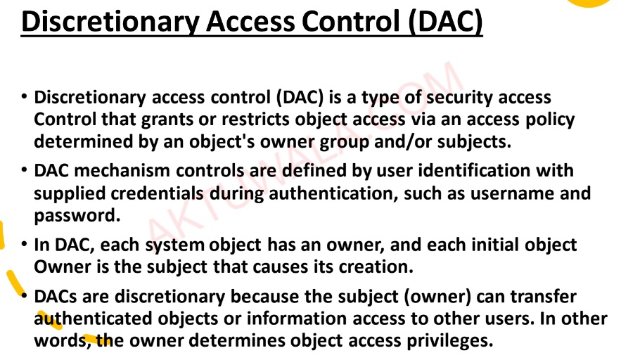

Slide 5
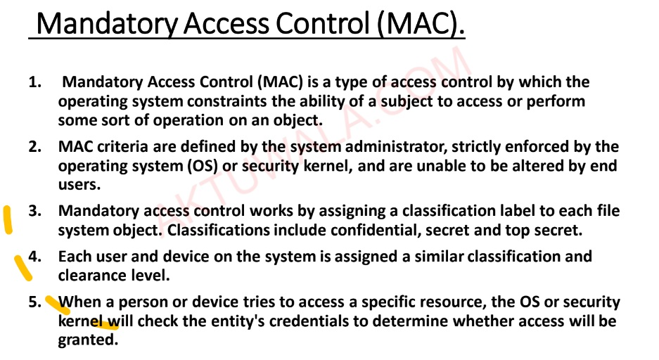

Slide 6
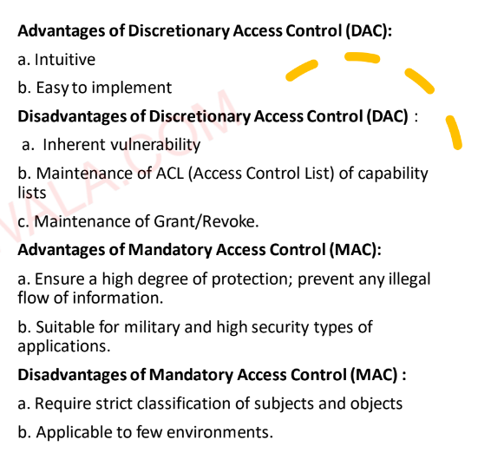

Slide 7
1. Buffer overflow attacks
A buffer is a temporary area for data storage. When more data (than was originally allocated tobe stored) gets placed by a program or system process, the extra data overflows. It causes someof that data to leak out into other buffers, which can corrupt or overwrite whatever data theywere holding.
In a buffer-overflow attack, the extra data sometimes holds specific instructions for actions intended by a hacker or malicious user; for example, the data could trigger a response that damages files, changes data or unveils private information.
Attacker would use a buffer-overflow exploit to take advantage of a program that is waiting on a user’s input.
There are two types of buffer overflows:
stack-based
heap-based

Slide 8
2. Interger overflow attacks
Integer overflows occur when the result of an arithmetic operation is a value, that is too large to fit in the available storage space.
Example:
a = 0xffffffff
b = 0x1
r = a + b

Slide 9
3. Format String attack
Format String bug is the one of the most common vulnerability in programs c.
Format string is a bug that occurs when format string printf (%d, %s) used in the printf () function is used in the wrong form.
Vulnerable code:
int main (int argc,char **argv)
{ printf(argv[1]);
}
Safer code: #include<stdio.h>
int main (int argc,char **argv)
{ printf( “%s”,argv[1]);
}

Slide 10
Format String attack
This is because the computer recognizes the input value as a formatting character rather than a character .
Format string attack generates an error when a developer accidentally writes a printf () code without variable, and hacker can use thus error to steal the root.
Two Vulnerabilities used in Format string attack:
1.If there is no format string factor after last entered format string, in terms of stack, from the time the printf () function is called, printf () consider in order from the stack top’s content as printf ()’s factors.
2. These format string store the number of bytes printed by printf () to int type pointer.
%n store as 4 bytes and %hn store as 2 bytes.

Slide 11
Format string vulnerabilities are a class of bug that take advantage of an easily avoidable programmer error. If the programmer passes an attacker-controlled buffer as an argument to a printf (or any of the related functions, including sprintf, fprintf, etc), the attacker can perform writes to arbitrary memory addresses.
The following program contains such an error:
int main (int argc, char** argv)
{
char buffer [100];
strncpy(buffer, argv[1], 100);
// We are passing command line
// argument to printf
printf(buffer);
return 0;
}

Slide 12
How can we prevent format string attack?
There are several prevention methods that we can use:
• Always specify a format string as part of program, not as an input.
• If possible, make the format string a constant. Extract all the variable parts as other arguments to the call.
• Use defences such as Format Guard. Rare at design time.
• Steadily to the patch system. The kernel development and security settings are more about Set UID and complement these vulnerabilities.
• Normal use of the printf function like below does not cause any problems.

Slide 13
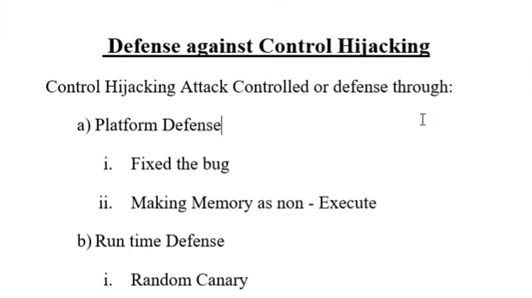

Slide 14
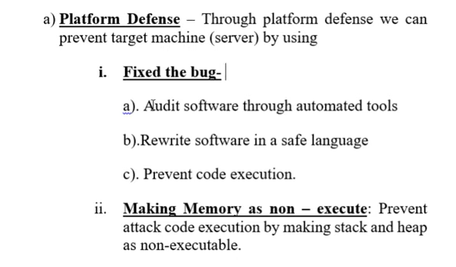

Slide 15
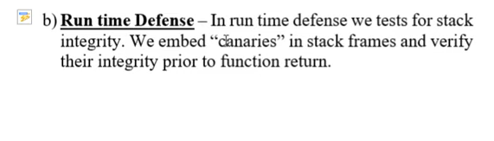
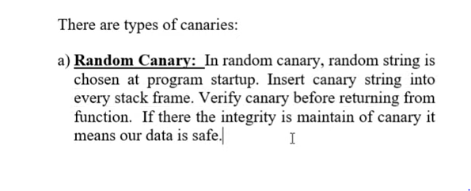

Slide 16
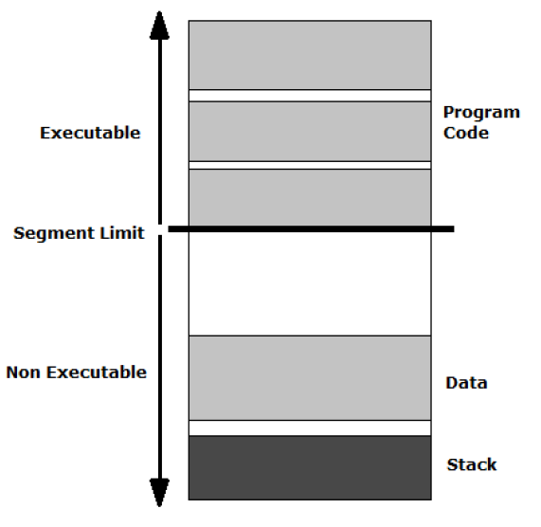
Defences against control hijacking-Platform Defence
Marking memory as non-execute
An attacker can often change the return address of the function and point them to an area within the buffer which contains shellcode. The first logical step in countering buffer overflows is to ensure that return addresses only point to trusted program code and not to hostile externally injected program code.This is the approach that ExecShield and NX Technology provided by AMD and Intel, take.

Slide 17
Defences against control hijacking-Run-Time Defence
StackGuard
Stack Guard basically works by inserting a small value known as a canary between the stack variables (buffers) and the function return address. When a stack-buffer overflows into the function return address, the canary is overwritten. During function return the canary value is checked and if the value has changed the program is terminated. Thus, reducing code execution to a mere denial of service attack. The performance cost of inserting and checking the canary is very small for the benefit it brings, and can be reduced further if the compiler detects that no local buffer variables are used by the function so the canary can be safely omitted.
Canaries
There are currently three types of canaries which are supported by StackGuard:
1) Terminator
2) Random canaries
3) random XOR canaries

Slide 18
Thank You

